Slide 1

MM TAPER
For internal use only
August 2025

Slide 2
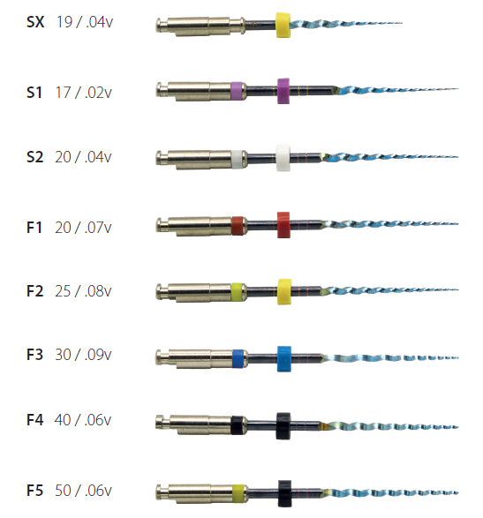
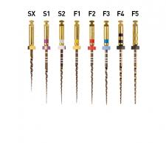
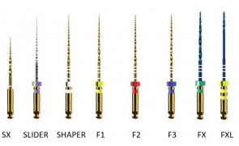
MM Taper
Alternative to ProTaper Gold or ProTaper Ultimate
ProTaper Gold
ProTaper Ultimate
MM TAPER

Slide 3
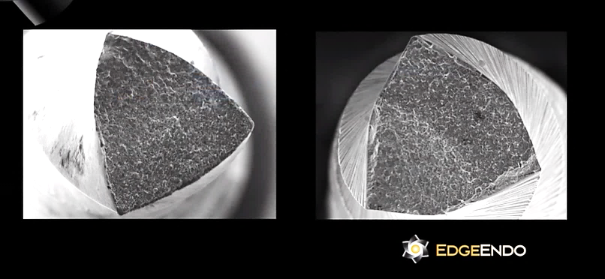
MM Taper
Continuous rotation – multiple files sequence
S.Wire : Flexibility
  Sterile Blister of 6 instruments – 1 opener, 2 shaping and 5 finishers
  Sizes: 19/04V, 17/02V, 20.04V, 20.07V, & 25.08V, 30/09V, 40/06V, 50/05V
  Lengths: 19mm, 21mm, 25mm, & 31mm
  Multiple use

Slide 4
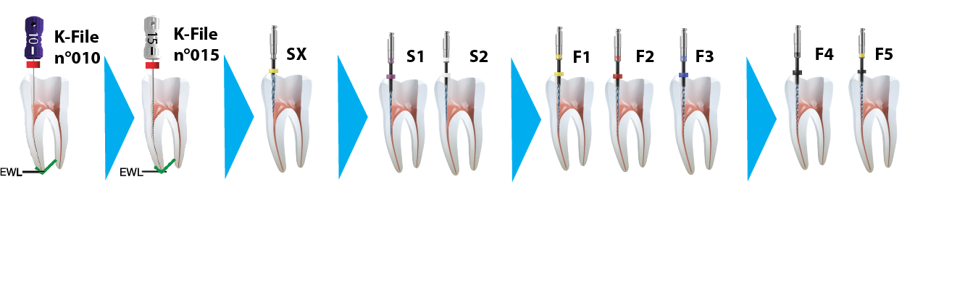
MM Taper
Identical protocol

Slide 5


MM Taper
 |  | MM TAPER
Diameter | (SX-F5) 19/04V, 17/02V, 20.04V, 20.07V, 25.08V, 30/09V, 40/06V, 50/05V | (SX-F5) 19/04V, 17/02V, 20.04V, 20.07V, 25.08V, 30/09V, 40/06V, 50/05V | SX 20/03V, Slider 16/02V, Shaper 20.04V, (F1)20.07V, (F2) 25.08V, (F3) 30/09V, (FX)35/12V., (FXL) 50/10.V
Taper | Variable | Variable | Variable
Protocole | Identical | Identical | Identical
Cross Section | Triangular | Triangular | Parallelogramme
Color of the blade | Gold | Blue | Gold
Heat Treatment | Gold | S.Wire | several
Flexibility |  | ⁺ | ⁺
Cyclic Fatigue resistance |  | ⁺ | ⁺
Cutting Efficiency | ⁺
Controlled Memory |  | ☑

